Slide 1
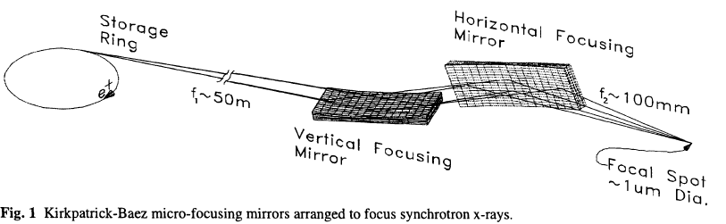
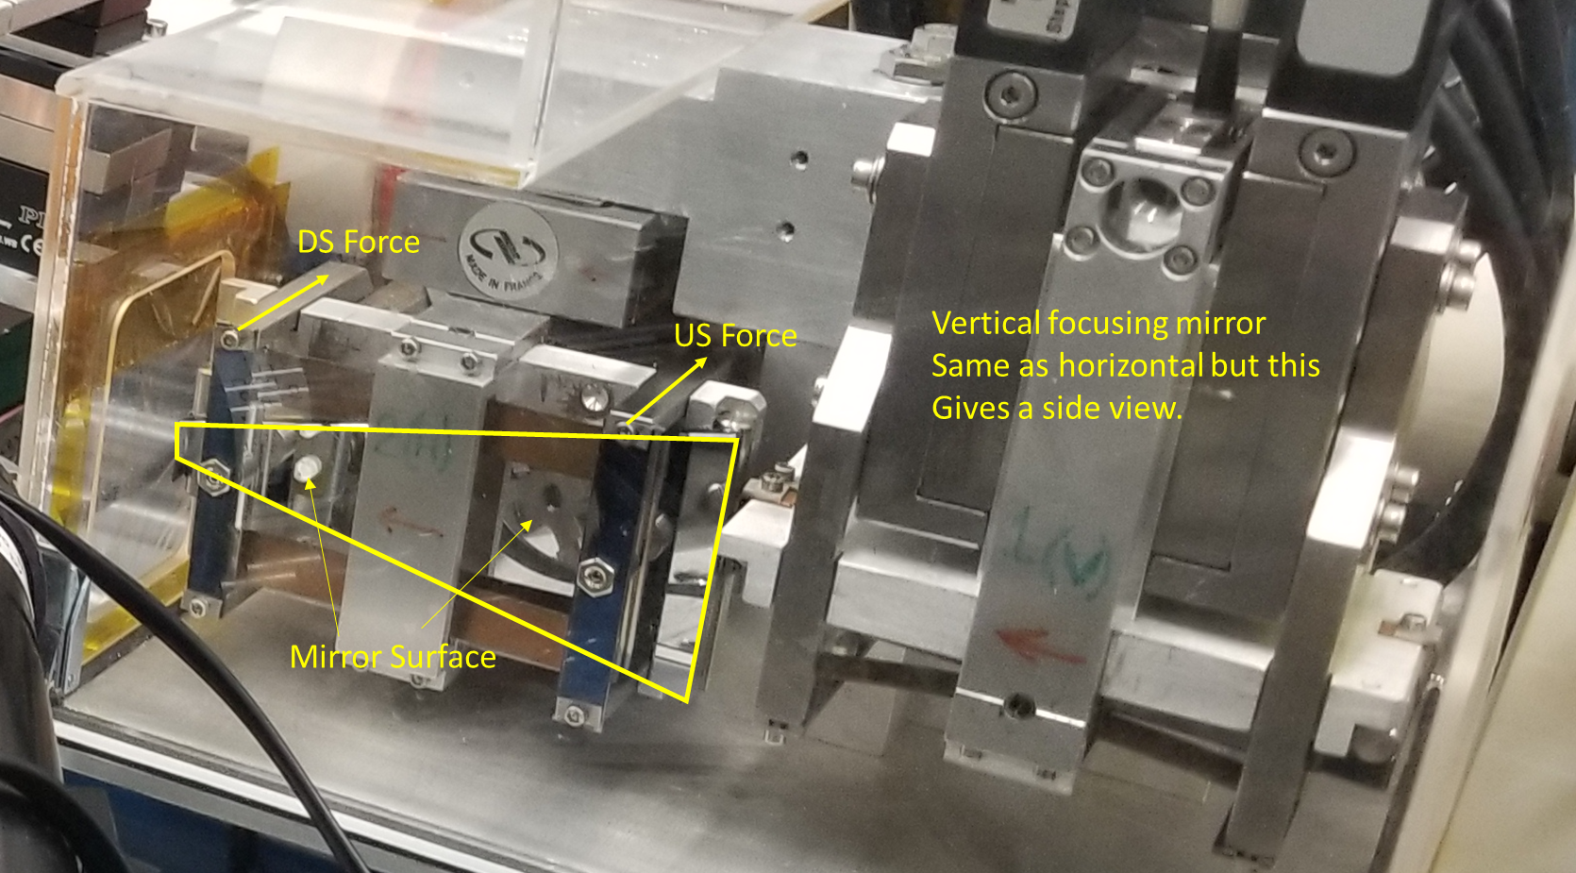
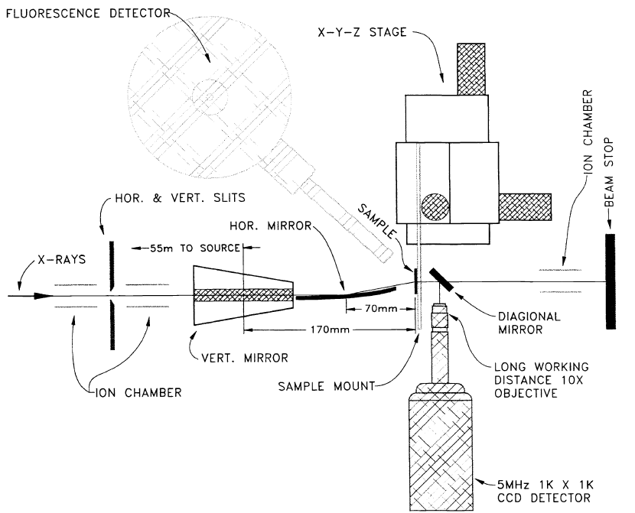
34ID KB Mirror System for X-ray Beam Focusing
Kirkpatrick-Baez micro-focusing mirrors arranged to focus synchrotron x-rays.
X-ray focusing setup at 34ID
Schematic of the x-ray focusing test setup
Peter Eng et al, Proceedings of SPIE (1998)

Slide 2
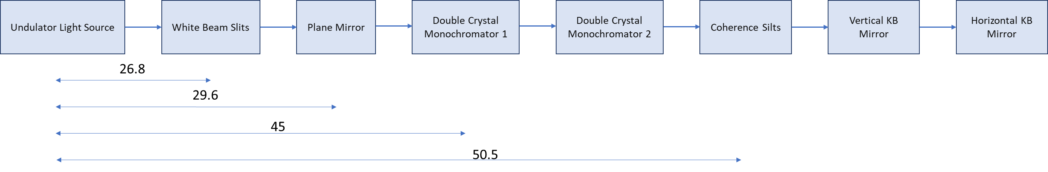
34ID Beamline Components

Slide 3
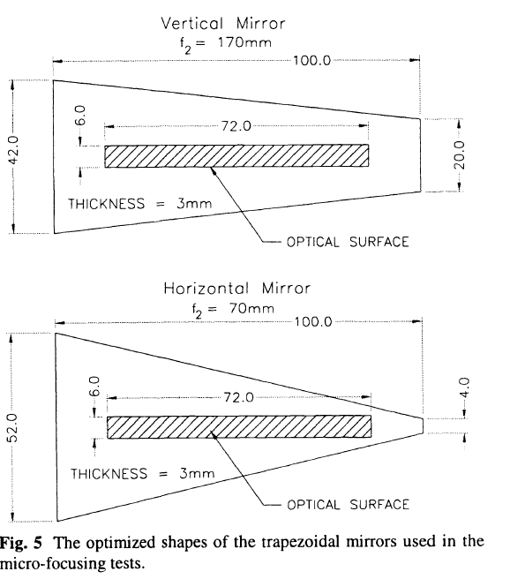
34ID KB Mirror Material and Dimensions
KB Mirror Material
Material: Silicon with Pt or Pd coating
KB Mirror Dimensions

Slide 4
34ID KB Mirror Motors
Motor | Vertical KB | Motor | Horizontal KB | Motor Specifications
Motor 1 | to adjust position perpendicular to beam | Motor 1 | to adjust position perpendicular to beam | micrometer resolution
Motor 2 | to adjust upstream bending force | Motor 2 | to adjust upstream bending force | Bender Motors All Identical (micrometer resolution)
Motor 3 | to adjust downstream bending force | Motor 3 | to adjust downstream bending force
Motor 4 | to adjust incident angle | Motor 4 | to adjust incident angle (range ± 20mrad)
Motor 5 | to adjust the position of the mirror in the direction of its surface normal | Motor 5 | to adjust the position of the mirror in the direction of its surface normal

